Slide 1
CS 332: Algorithms
Solving Recurrences Continued
The Master Theorem
Introduction to heapsort

Slide 2
Review: Merge Sort
MergeSort(A, left, right) {
if (left < right) {
mid = floor((left + right) / 2);
MergeSort(A, left, mid);
MergeSort(A, mid+1, right);
Merge(A, left, mid, right);
}
}
// Merge() takes two sorted subarrays of A and
// merges them into a single sorted subarray of A.
// Code for this is in the book. It requires O(n)
// time, and *does* require allocating O(n) space

Slide 3
Review: Analysis of Merge Sort
Statement Effort
So T(n) = Θ(1) when n = 1, and 2T(n/2) + Θ(n) when n > 1
This expression is a recurrence
MergeSort(A, left, right) { T(n)
if (left < right) { Θ(1)
mid = floor((left + right) / 2); Θ(1)
MergeSort(A, left, mid); T(n/2)
MergeSort(A, mid+1, right); T(n/2)
Merge(A, left, mid, right); Θ(n)
}
}

Slide 4
Review: Solving Recurrences
Substitution method
Iteration method
Master method

Slide 5
Review: Solving Recurrences
The substitution method
  A.k.a. the “making a good guess method”
  Guess the form of the answer, then use induction to find the constants and show that solution works
  Run an example: merge sort
    T(n) = 2T(n/2) + cn
    We guess that the answer is O(n lg n)
    Prove it by induction
  Can similarly show T(n) = Ω(n lg n), thus Θ(n lg n)

Slide 6
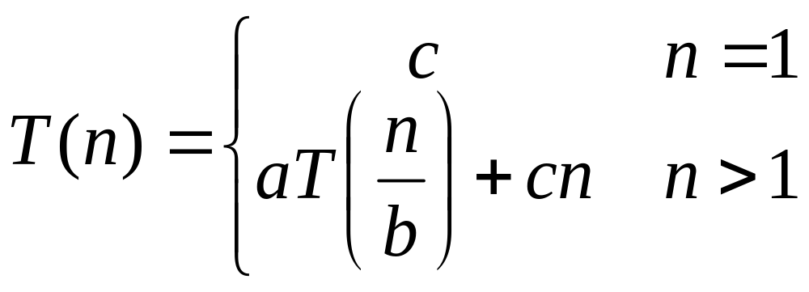
Review: Solving Recurrences
The “iteration method”
  Expand the recurrence
  Work some algebra to express as a summation
  Evaluate the summation
We showed several examples, were in the middle of:

Slide 7
T(n) =
aT(n/b) + cn
a(aT(n/b/b) + cn/b) + cn
a²T(n/b²) + cna/b + cn
a²T(n/b²) + cn(a/b + 1)
a²(aT(n/b²/b) + cn/b²) + cn(a/b + 1)
a³T(n/b³) + cn(a²/b²) + cn(a/b + 1)
a³T(n/b³) + cn(a²/b² + a/b + 1)
…
a^{k}T(n/b^{k}) + cn(a^{k-1}/b^{k-1} + a^{k-2}/b^{k-2} + … + a²/b² + a/b + 1)

Slide 8
So we have
  T(n) = a^{k}T(n/b^{k}) + cn(a^{k-1}/b^{k-1} + ... + a²/b² + a/b + 1)
For k = log_{b} n
  n = b^{k}
  T(n) = a^{k}T(1) + cn(a^{k-1}/b^{k-1} + ... + a²/b² + a/b + 1)
  = a^{k}c + cn(a^{k-1}/b^{k-1} + ... + a²/b² + a/b + 1)
  = ca^{k} + cn(a^{k-1}/b^{k-1} + ... + a²/b² + a/b + 1)
  = cna^{k} /b^{k} + cn(a^{k-1}/b^{k-1} + ... + a²/b² + a/b + 1)
  = cn(a^{k}/b^{k} + ... + a²/b² + a/b + 1)

Slide 9
So with k = log_{b} n
  T(n) = cn(a^{k}/b^{k} + ... + a²/b² + a/b + 1)
What if a = b?
  T(n) = cn(k + 1)
  = cn(log_{b} n + 1)
  = Θ(n log n)

Slide 10
So with k = log_{b} n
  T(n) = cn(a^{k}/b^{k} + ... + a²/b² + a/b + 1)
What if a < b?

Slide 11
So with k = log_{b} n
  T(n) = cn(a^{k}/b^{k} + ... + a²/b² + a/b + 1)
What if a < b?
  Recall that Σ(x^{k} + x^{k-1} + … + x + 1) = (x^{k+1} -1)/(x-1)

Slide 12
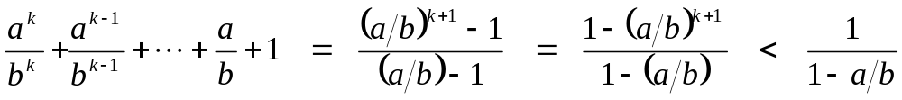
So with k = log_{b} n
  T(n) = cn(a^{k}/b^{k} + ... + a²/b² + a/b + 1)
What if a < b?
  Recall that (x^{k} + x^{k-1} + … + x + 1) = (x^{k+1} -1)/(x-1)
  So:

Slide 13
So with k = log_{b} n
  T(n) = cn(a^{k}/b^{k} + ... + a²/b² + a/b + 1)
What if a < b?
  Recall that Σ(x^{k} + x^{k-1} + … + x + 1) = (x^{k+1} -1)/(x-1)
  So:
  T(n) = cn ·Θ(1) = Θ(n)

Slide 14
So with k = log_{b} n
  T(n) = cn(a^{k}/b^{k} + ... + a²/b² + a/b + 1)
What if a > b?

Slide 15
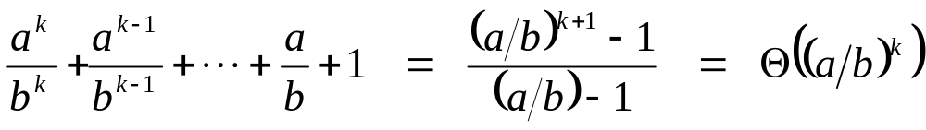
So with k = log_{b} n
  T(n) = cn(a^{k}/b^{k} + ... + a²/b² + a/b + 1)
What if a > b?

Slide 16
So with k = log_{b} n
  T(n) = cn(a^{k}/b^{k} + ... + a²/b² + a/b + 1)
What if a > b?
  T(n) = cn · Θ(a^{k} / b^{k})

Slide 17
So with k = log_{b} n
  T(n) = cn(a^{k}/b^{k} + ... + a²/b² + a/b + 1)
What if a > b?
  T(n) = cn · Θ(a^{k} / b^{k})
  = cn · Θ(a^{log n} / b^{log n}) = cn · Θ(a^{log n} / n)

Slide 18
So with k = log_{b} n
  T(n) = cn(a^{k}/b^{k} + ... + a²/b² + a/b + 1)
What if a > b?
  T(n) = cn · Θ(a^{k} / b^{k})
  = cn · Θ(a^{log n} / b^{log n}) = cn · Θ(a^{log n} / n)
  recall logarithm fact: a^{log n} = n^{log a}

Slide 19
So with k = log_{b} n
  T(n) = cn(a^{k}/b^{k} + ... + a²/b² + a/b + 1)
What if a > b?
  T(n) = cn · Θ(a^{k} / b^{k})
  = cn · Θ(a^{log n} / b^{log n}) = cn · Θ(a^{log n} / n)
  recall logarithm fact: a^{log n} = n^{log a}
  = cn · Θ(n^{log a} / n) = Θ(cn · n^{log a} / n)

Slide 20
So with k = log_{b} n
  T(n) = cn(a^{k}/b^{k} + ... + a²/b² + a/b + 1)
What if a > b?
  T(n) = cn · Θ(a^{k} / b^{k})
  = cn · Θ(a^{log n} / b^{log n}) = cn · Θ(a^{log n} / n)
  recall logarithm fact: a^{log n} = n^{log a}
  = cn · Θ(n^{log a} / n) = Θ(cn · n^{log a} / n)
  = Θ(n^{log a} )

Slide 21
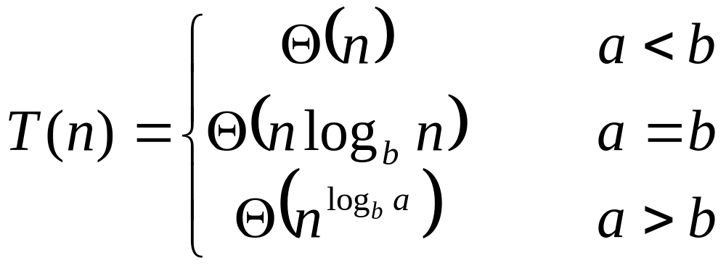
So…

Slide 22
The Master Theorem
Given: a divide and conquer algorithm
  An algorithm that divides the problem of size n into a subproblems, each of size n/b
  Let the cost of each stage (i.e., the work to divide the problem + combine solved subproblems) be described by the function f(n)
Then, the Master Theorem gives us a cookbook for the algorithm’s running time:

Slide 23
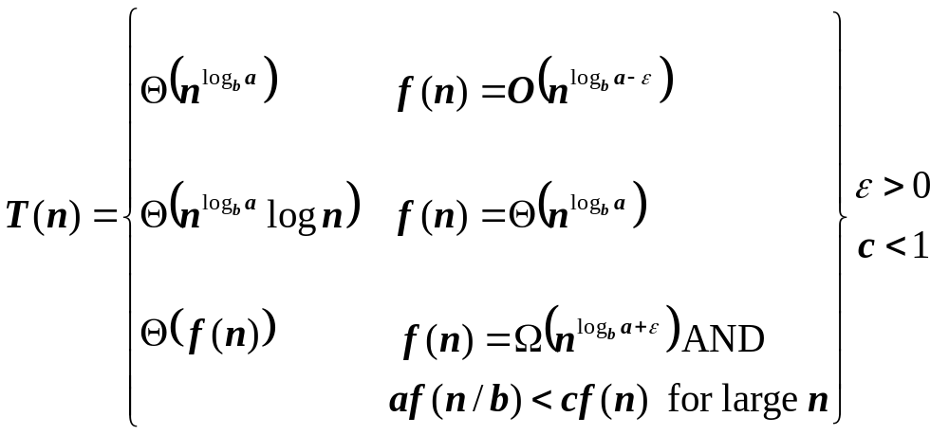
The Master Theorem
if T(n) = aT(n/b) + f(n) then

Slide 24
Using The Master Method
T(n) = 9T(n/3) + n
  a=9, b=3, f(n) = n
  n^{logb a} = n^{log3 9} = Θ(n²)
  Since f(n) = O(n^{log3 9 - ε}), where ε=1, case 1 applies:
  Thus the solution is T(n) = Θ(n²)

Slide 25
Sorting Revisited
So far we’ve talked about two algorithms to sort an array of numbers
  What is the advantage of merge sort?
  What is the advantage of insertion sort?
Next on the agenda: Heapsort
  Combines advantages of both previous algorithms

Slide 26
Heaps
A heap can be seen as a complete binary tree:
  What makes a binary tree complete?
  Is the example above complete?
16
14
10
8
7
9
3
2
4
1

Slide 27
Heaps
A heap can be seen as a complete binary tree:
  The book calls them “nearly complete” binary trees; can think of unfilled slots as null pointers
16
14
10
8
7
9
3
2
4
1
1
1
1
1
1

Slide 28
Heaps
In practice, heaps are usually implemented as arrays:
16
14
10
A =
16
14
10
8
7
9
3
2
4
1
=
8
7
9
3
2
4
1

Slide 29
Heaps
To represent a complete binary tree as an array:
  The root node is A[1]
  Node i is A[i]
  The parent of node i is A[i/2] (note: integer divide)
  The left child of node i is A[2i]
  The right child of node i is A[2i + 1]
16
14
10
A =
16
14
10
8
7
9
3
2
4
1
=
8
7
9
3
2
4
1

Slide 30
Referencing Heap Elements
So…
  Parent(i) { return ⎣i/2⎦; }
  Left(i) { return 2*i; }
  right(i) { return 2*i + 1; }
An aside: How would you implement this
most efficiently?
Another aside: Really?

Slide 31
The Heap Property
Heaps also satisfy the heap property:
A[Parent(i)] ≥ A[i] for all nodes i > 1
  In other words, the value of a node is at most the value of its parent
  Where is the largest element in a heap stored?
Definitions:
  The height of a node in the tree = the number of edges on the longest downward path to a leaf
  The height of a tree = the height of its root

Slide 32
Heap Height
What is the height of an n-element heap? Why?
This is nice: basic heap operations take at most time proportional to the height of the heap

Slide 33
Heap Operations: Heapify()
Heapify(): maintain the heap property
  Given: a node i in the heap with children l and r
  Given: two subtrees rooted at l and r, assumed to be heaps
  Problem: The subtree rooted at i may violate the heap property (How?)
  Action: let the value of the parent node “float down” so subtree at i satisfies the heap property
    What do you suppose will be the basic operation between i, l, and r?

Slide 34
Heap Operations: Heapify()
Heapify(A, i)
{
l = Left(i); r = Right(i);
if (l <= heap_size(A) && A[l] > A[i])
largest = l;
else
largest = i;
if (r <= heap_size(A) && A[r] > A[largest])
largest = r;
if (largest != i)
Swap(A, i, largest);
Heapify(A, largest);
}

Slide 35
Heapify() Example
16
4
10
14
7
9
3
2
8
1
A =
16
4
10
14
7
9
3
2
8
1

Slide 36
Heapify() Example
16
4
10
14
7
9
3
2
8
1
A =
16
4
10
14
7
9
3
2
8
1

Slide 37
Heapify() Example
16
4
10
14
7
9
3
2
8
1
A =
16
4
10
14
7
9
3
2
8
1

Slide 38
Heapify() Example
16
14
10
4
7
9
3
2
8
1
A =
16
14
10
4
7
9
3
2
8
1

Slide 39
Heapify() Example
16
14
10
4
7
9
3
2
8
1
A =
16
14
10
4
7
9
3
2
8
1

Slide 40
Heapify() Example
16
14
10
4
7
9
3
2
8
1
A =
16
14
10
4
7
9
3
2
8
1

Slide 41
Heapify() Example
16
14
10
8
7
9
3
2
4
1
A =
16
14
10
8
7
9
3
2
4
1

Slide 42
Heapify() Example
16
14
10
8
7
9
3
2
4
1
A =
16
14
10
8
7
9
3
2
4
1

Slide 43
Heapify() Example
16
14
10
8
7
9
3
2
4
1
A =
16
14
10
8
7
9
3
2
4
1

Slide 44
Analyzing Heapify(): Informal
Aside from the recursive call, what is the running time of Heapify()?
How many times can Heapify() recursively call itself?
What is the worst-case running time of Heapify() on a heap of size n?

Slide 45
Analyzing Heapify(): Formal
Fixing up relationships between i, l, and r takes Θ(1) time
If the heap at i has n elements, how many elements can the subtrees at l or r have?
  Draw it
Answer: 2n/3 (worst case: bottom row 1/2 full)
So time taken by Heapify() is given by
T(n) ≤ T(2n/3) + Θ(1)

Slide 46
Analyzing Heapify(): Formal
So we have
T(n) ≤ T(2n/3) + Θ(1)
By case 2 of the Master Theorem,
T(n) = O(lg n)
Thus, Heapify() takes linear time

Slide 47
Heap Operations: BuildHeap()
We can build a heap in a bottom-up manner by running Heapify() on successive subarrays
  Fact: for array of length n, all elements in range
  A[⎣n/2⎦ + 1 .. n] are heaps (Why?)
  So:
    Walk backwards through the array from n/2 to 1, calling Heapify() on each node.
    Order of processing guarantees that the children of node i are heaps when i is processed

Slide 48
BuildHeap()
// given an unsorted array A, make A a heap
BuildHeap(A)
{
heap_size(A) = length(A);
for (i = ⎣length[A]/2⎦ downto 1)
Heapify(A, i);
}

Slide 49
BuildHeap() Example
Work through example
A = {4, 1, 3, 2, 16, 9, 10, 14, 8, 7}
4
1
3
2
16
9
10
14
8
7

Slide 50
Analyzing BuildHeap()
Each call to Heapify() takes O(lg n) time
There are O(n) such calls (specifically, ⎣n/2⎦)
Thus the running time is O(n lg n)
  Is this a correct asymptotic upper bound?
  Is this an asymptotically tight bound?
A tighter bound is O(n)
  How can this be? Is there a flaw in the above reasoning?

Slide 51
Analyzing BuildHeap(): Tight
To Heapify() a subtree takes O(h) time where h is the height of the subtree
  h = O(lg m), m = # nodes in subtree
  The height of most subtrees is small
Fact: an n-element heap has at most ⎡n/2^{h+1}⎤ nodes of height h
CLR 7.3 uses this fact to prove that BuildHeap() takes O(n) time

Slide 52
Heapsort
Given BuildHeap(), an in-place sorting algorithm is easily constructed:
  Maximum element is at A[1]
  Discard by swapping with element at A[n]
    Decrement heap_size[A]
    A[n] now contains correct value
  Restore heap property at A[1] by calling Heapify()
  Repeat, always swapping A[1] for A[heap_size(A)]

Slide 53
Heapsort
Heapsort(A)
{
BuildHeap(A);
for (i = length(A) downto 2)
{
Swap(A[1], A[i]);
heap_size(A) -= 1;
Heapify(A, 1);
}
}

Slide 54
Analyzing Heapsort
The call to BuildHeap() takes O(n) time
Each of the n - 1 calls to Heapify() takes O(lg n) time
Thus the total time taken by HeapSort()
= O(n) + (n - 1) O(lg n)
= O(n) + O(n lg n)
= O(n lg n)

Slide 55
Priority Queues
Heapsort is a nice algorithm, but in practice Quicksort (coming up) usually wins
But the heap data structure is incredibly useful for implementing priority queues
  A data structure for maintaining a set S of elements, each with an associated value or key
  Supports the operations Insert(), Maximum(), and ExtractMax()
  What might a priority queue be useful for?

Slide 56
Priority Queue Operations
Insert(S, x) inserts the element x into set S
Maximum(S) returns the element of S with the maximum key
ExtractMax(S) removes and returns the element of S with the maximum key
How could we implement these operations using a heap?

